Slide 1


Slide 2


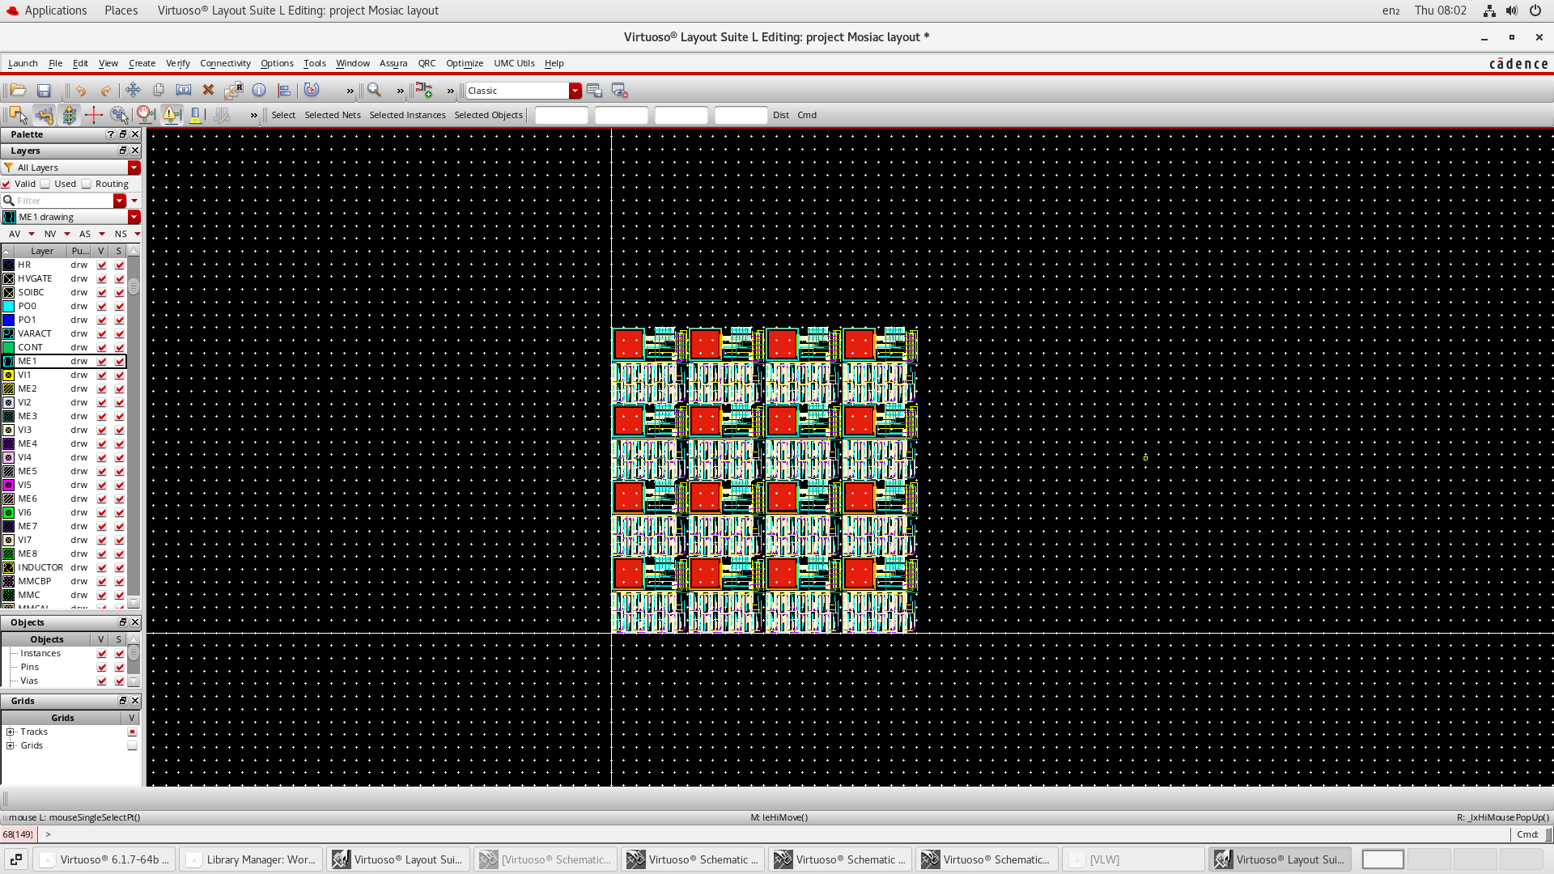
Digital Pixel Project
Owen Santoso Jonathan Hyman Sebastian Hasleby Shami Mohdar
Notes:
Owen

Slide 3


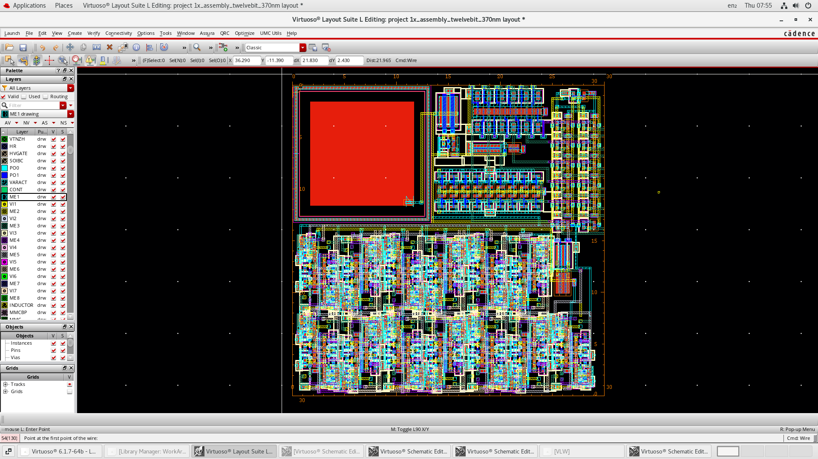
Executive Summary
12–bit binary counter
HDR feature implemented
Functional overflow protection
1.2V Vn recharge successful
488 total transistors
Notes:
Owen

Slide 4
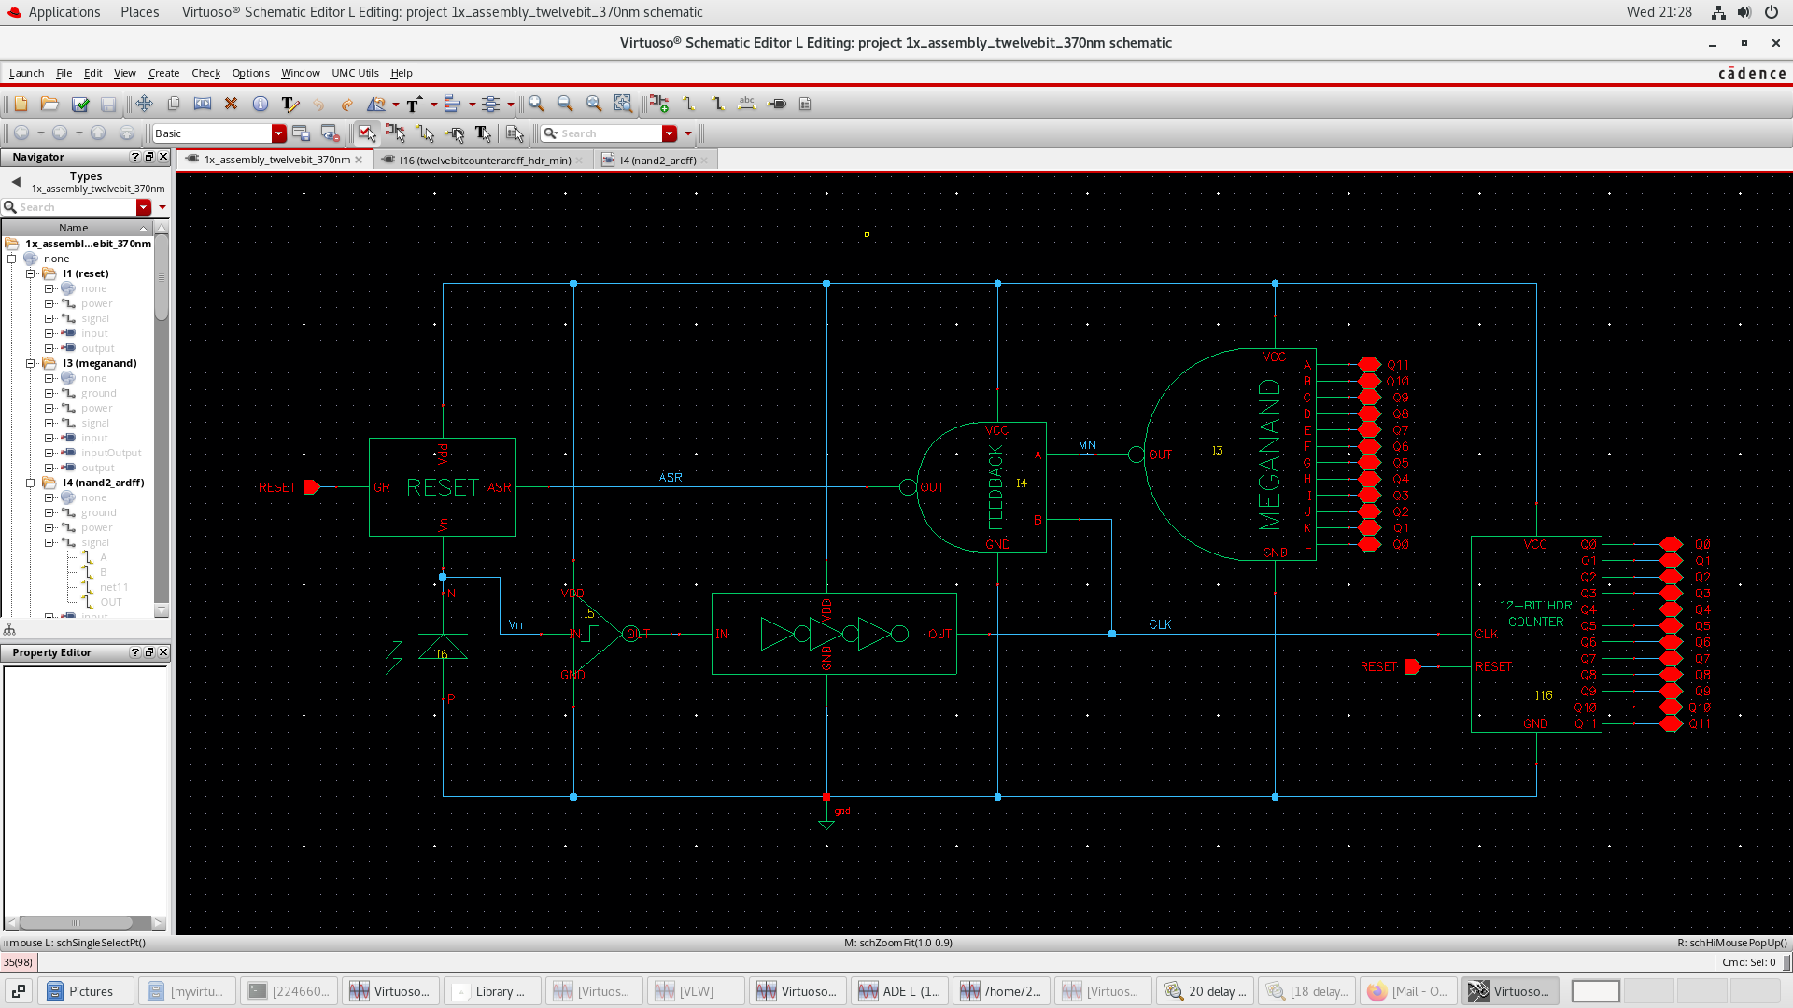
Full Pixel Schematic

Slide 5
Comparator
Notes:
Seb

Slide 6
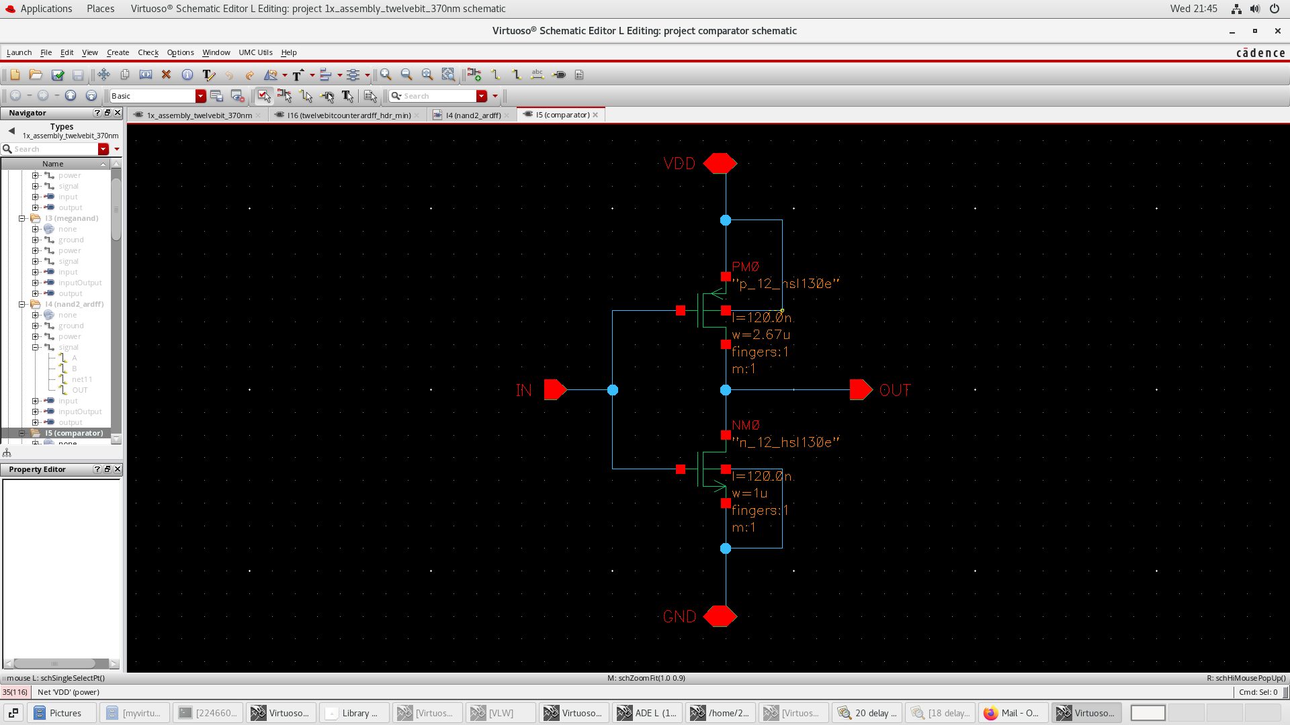
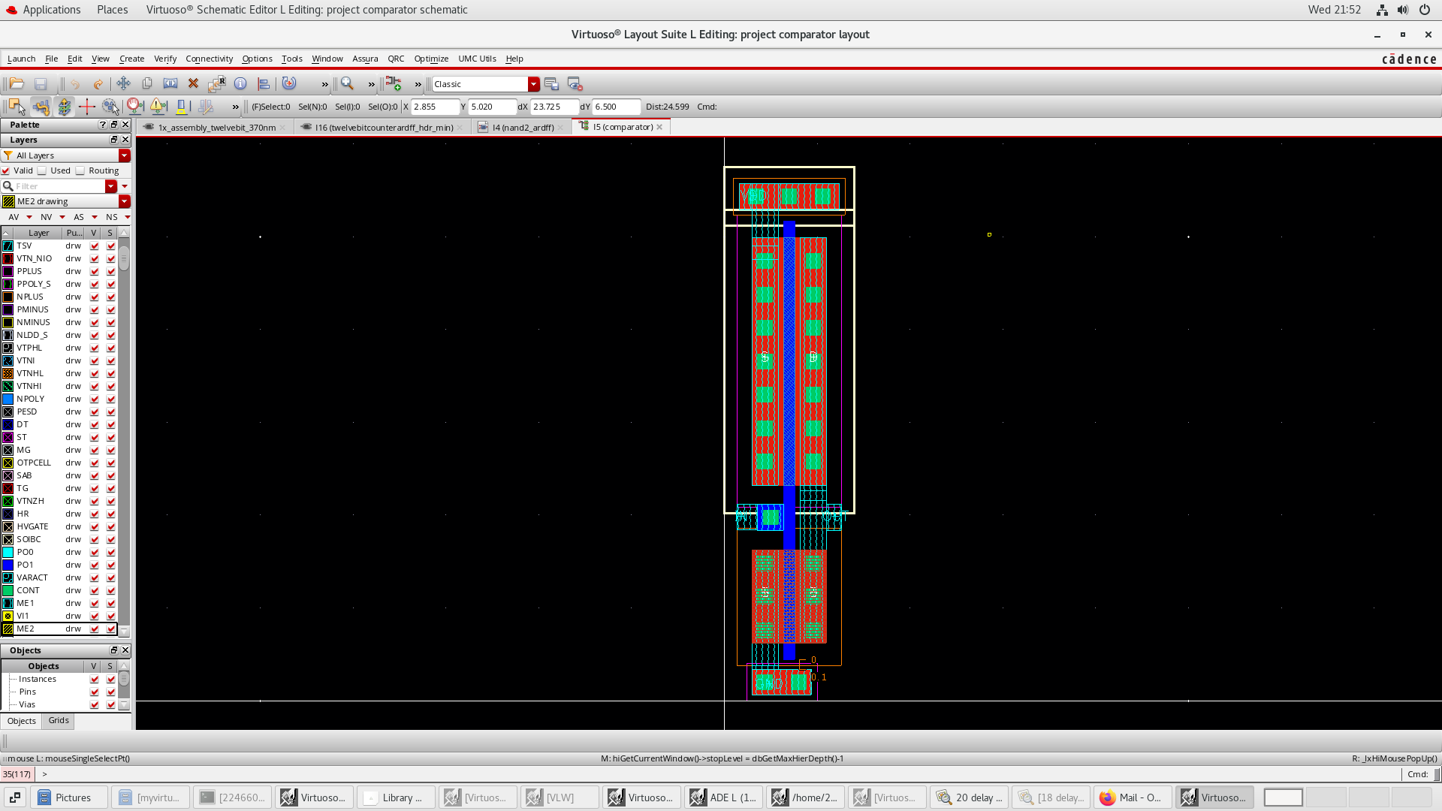
Comparator - Schematic & Layout
0.6V switching
2.67:1 ratio
NMOS: L=120nm, W=1um
PMOS: L=120nm, W=2.67um
Notes:
Seb

Slide 7
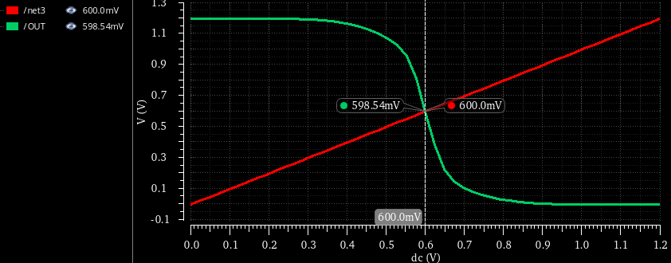
Comparator
0.6V switching
Notes:
Seb

Slide 8
Full Pixel Schematic

Slide 9
Delay Chain
Notes:
Owen

Slide 10
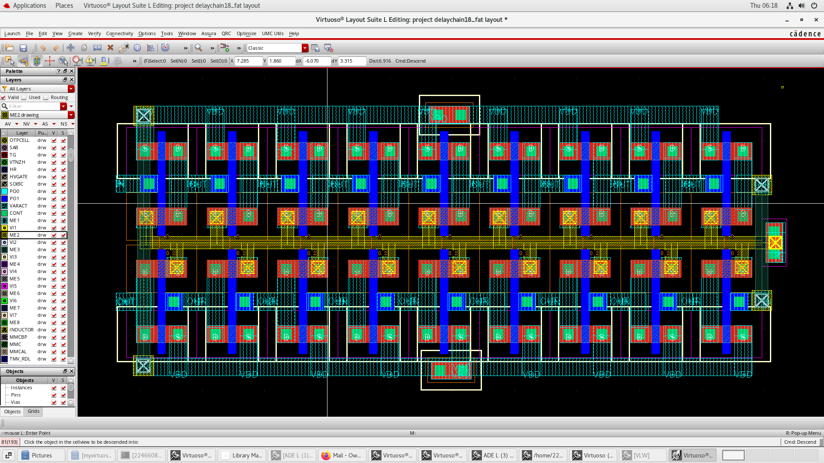
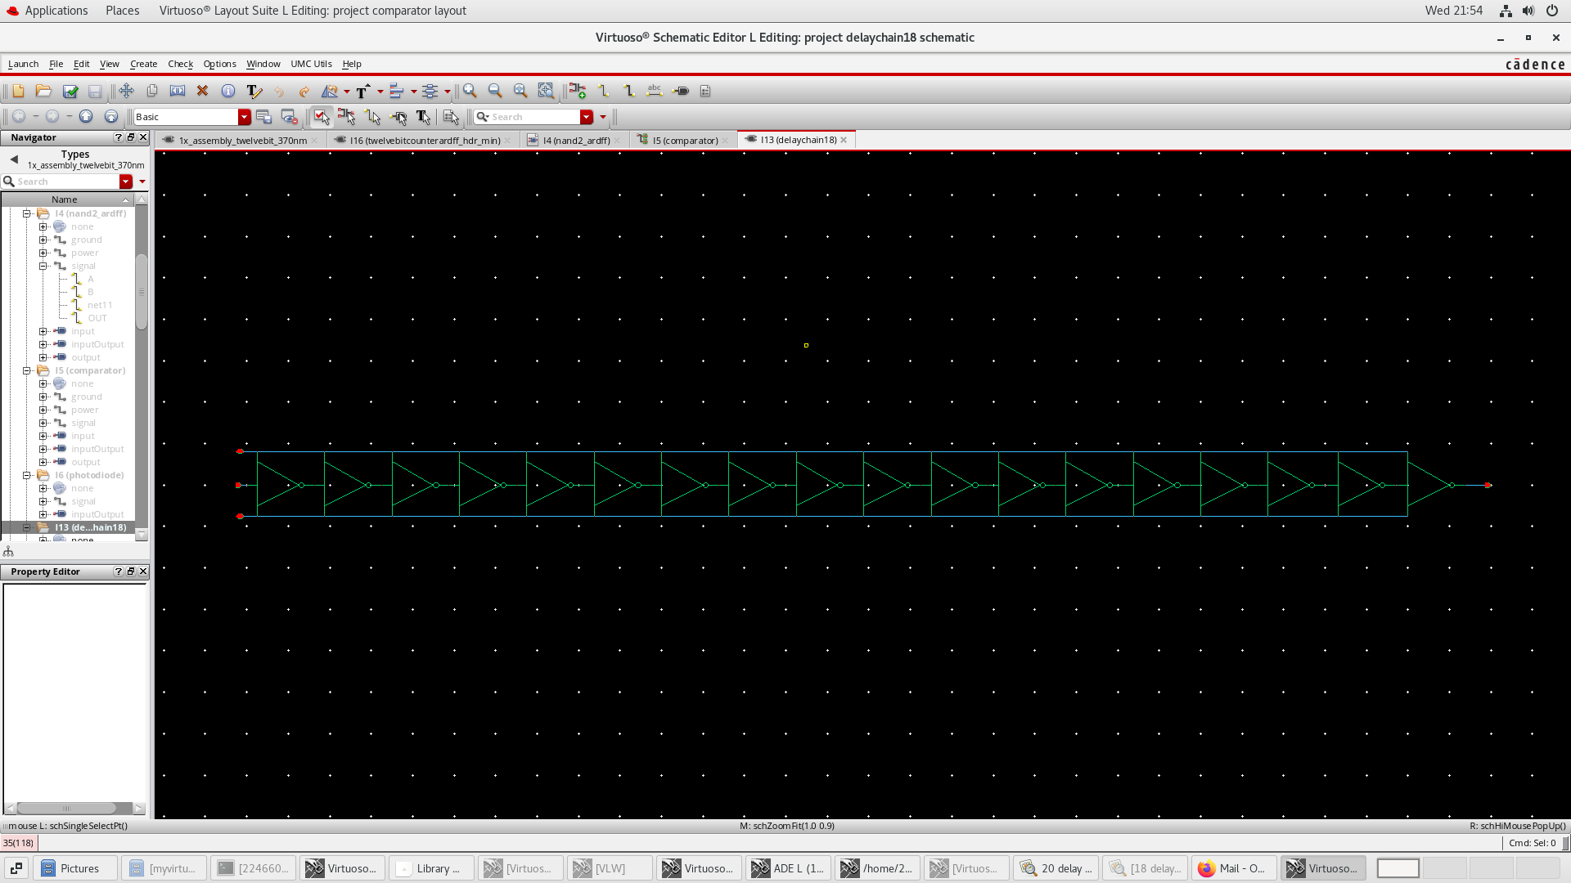
Delay Chain – Schematic & Layout
18 inverters
Determined iteratively through simulation
Notes:
Owen

Slide 11
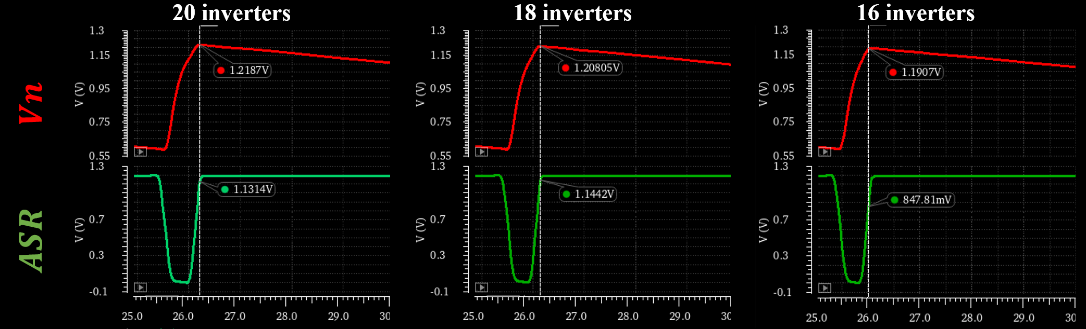
Delay Chain – Simulation
Determined iteratively through simulation
Lowest number of inverters to charge Vn to 1.2V
Notes:
Owen

Slide 12
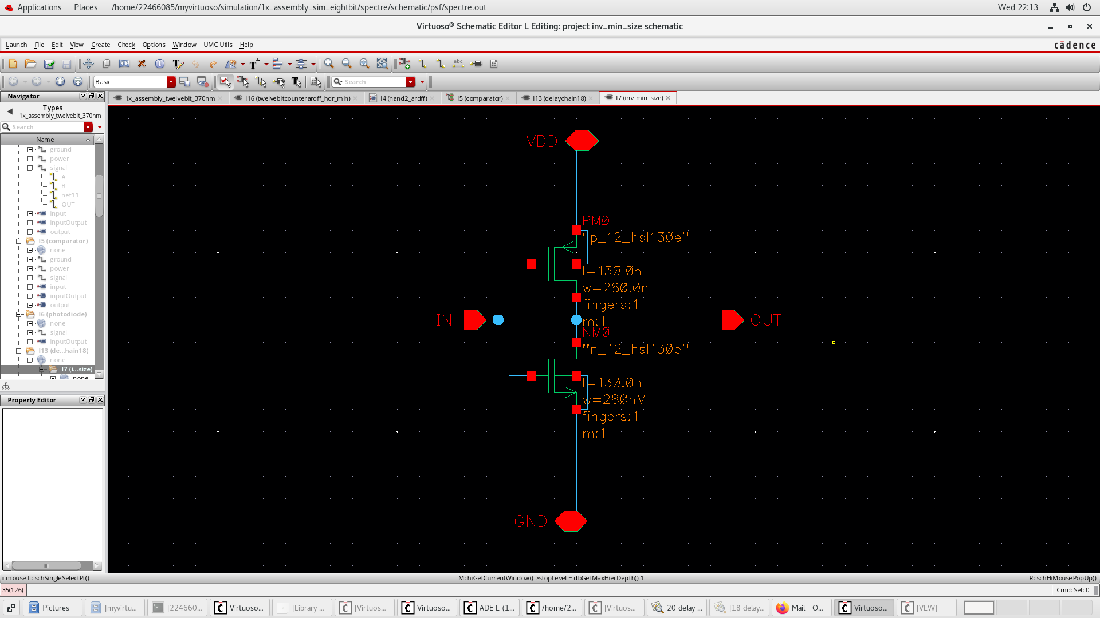
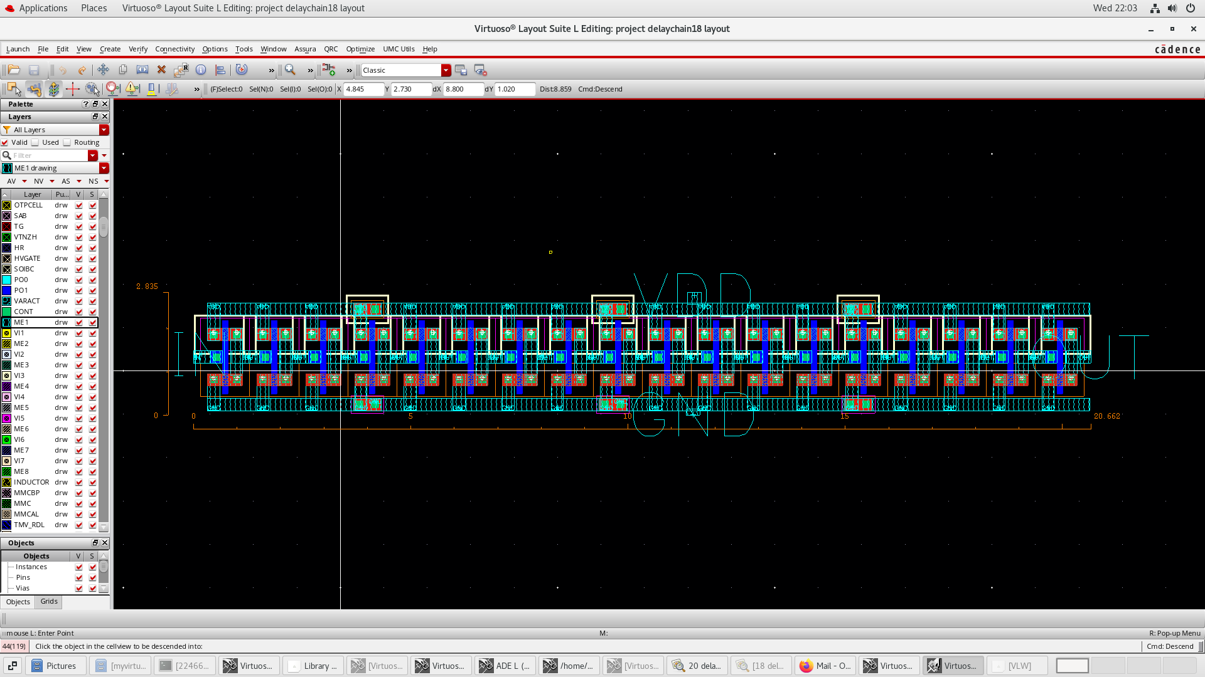
Delay Chain – Inverter
Sizing for smallest area:
L=130n
W=280n
(W kept the same as the minimum source drain metal width)
Notes:
Owen

Slide 13
Full Pixel Schematic

Slide 14
12–bit HDR Binary Counter
12–bits implemented
HDR feature implemented
D flip-flops
Notes:
Jonny

Slide 15
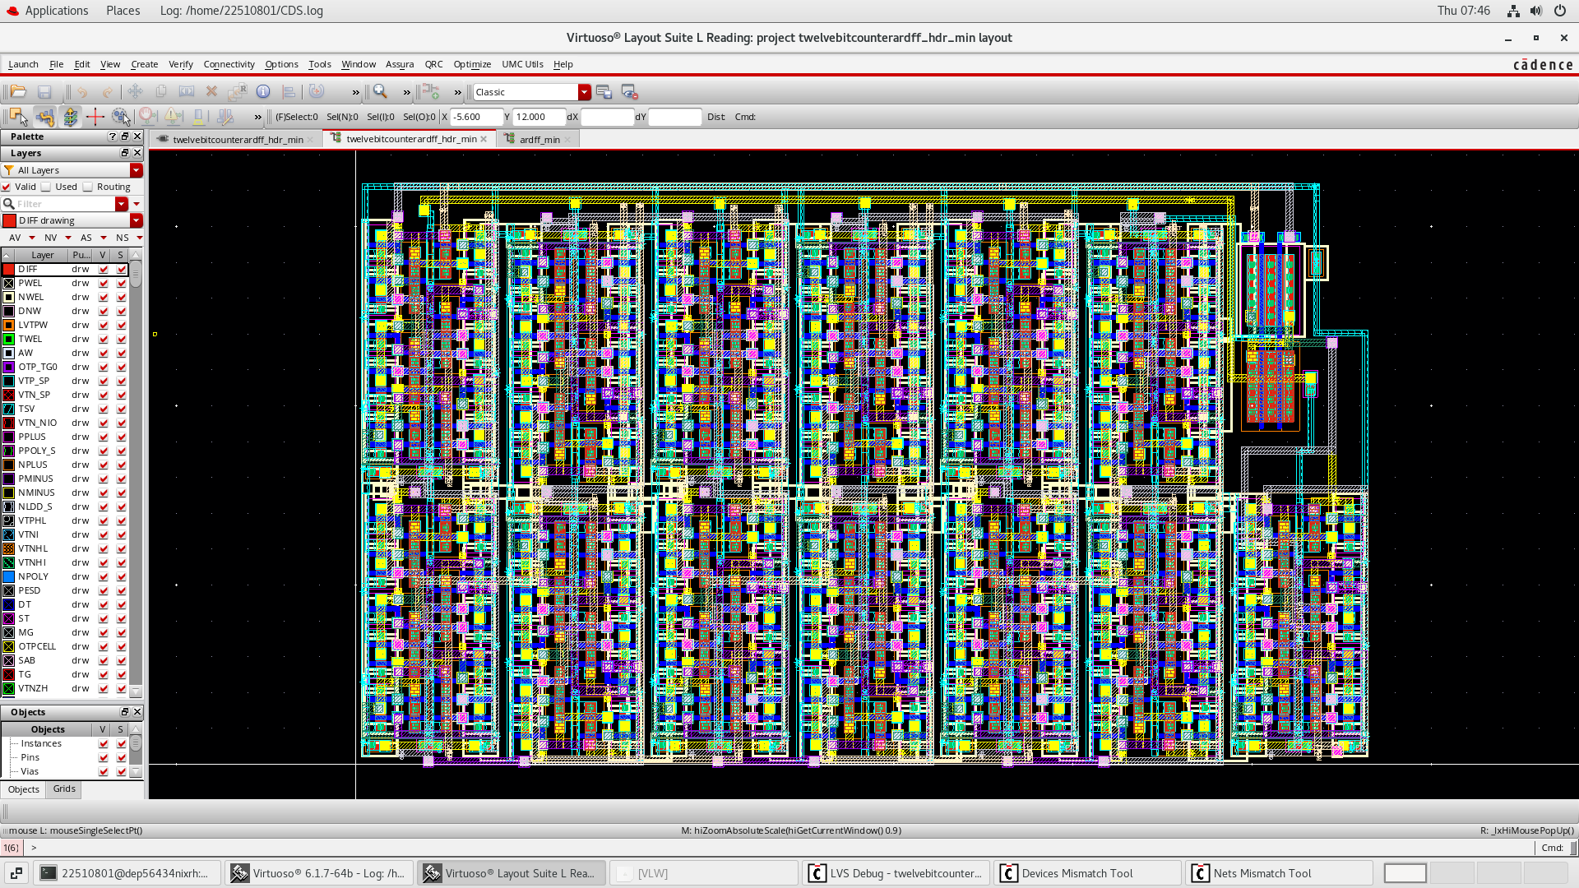
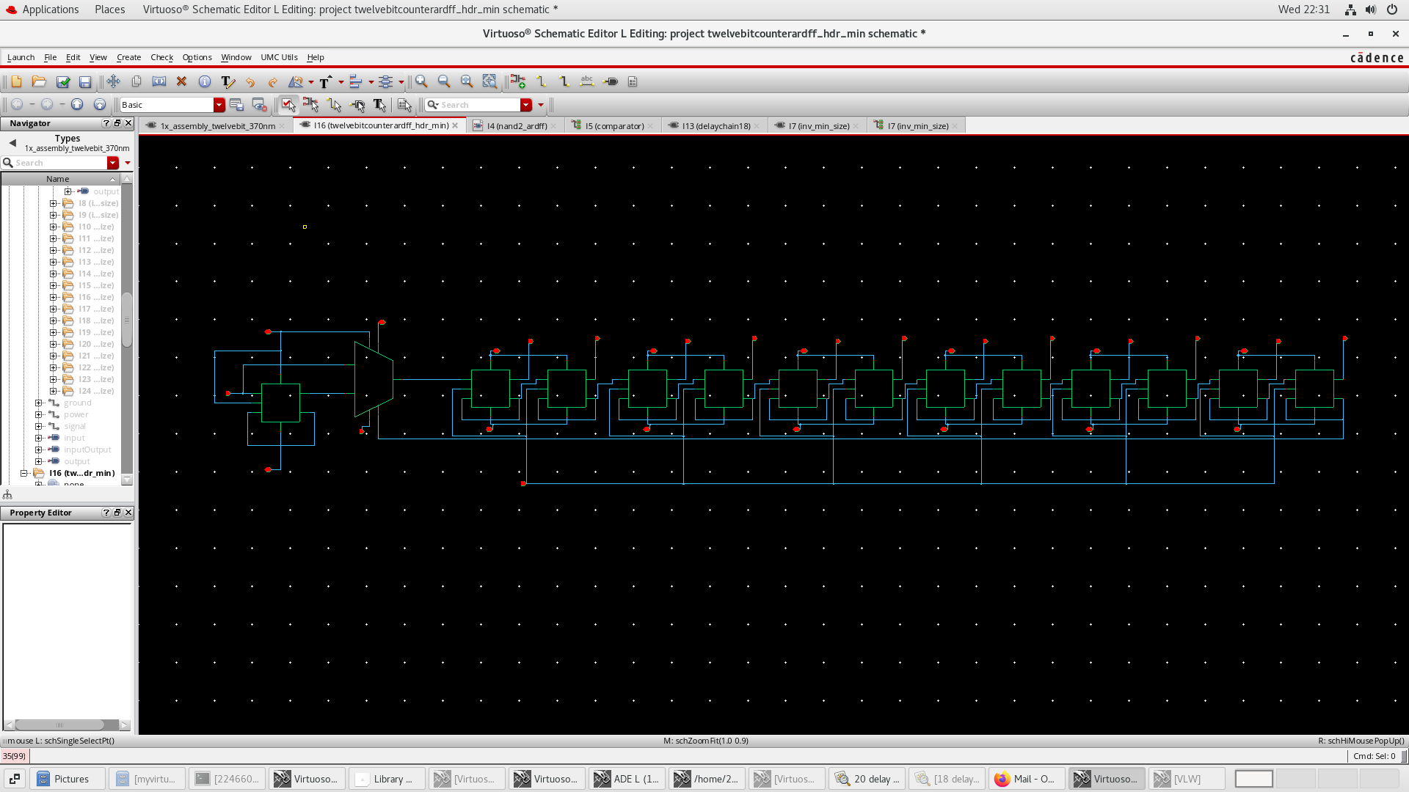
12-bit HDR Binary Counter Layout & Schematic
Notes:
Jonny

Slide 16
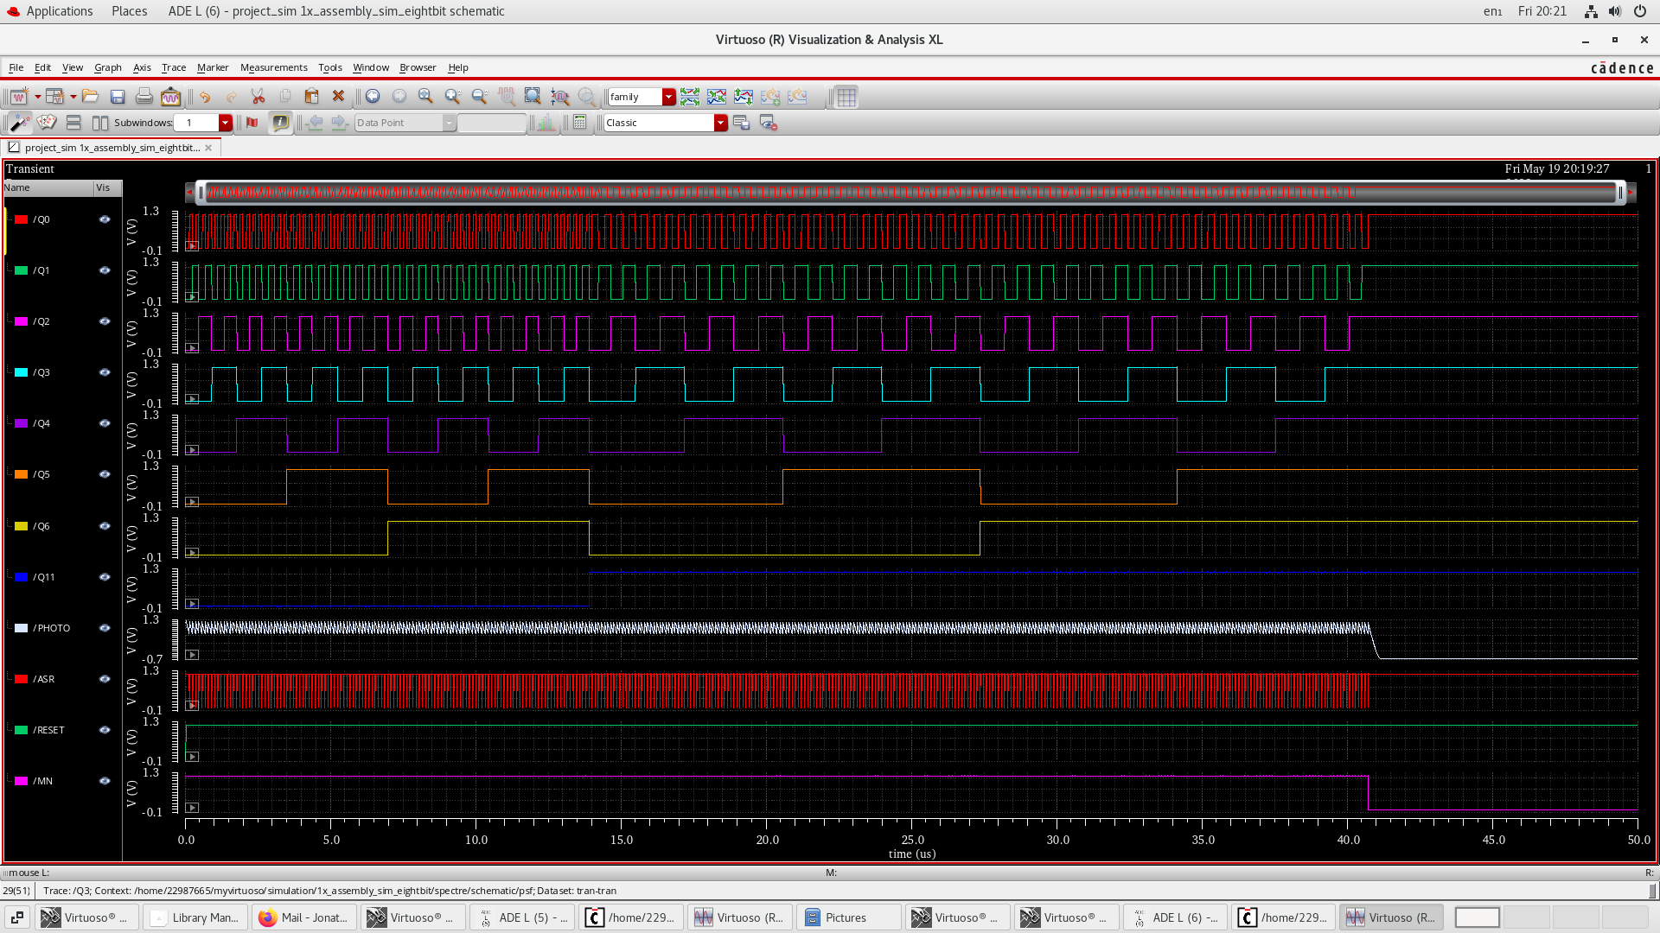
12-bit HDR Binary Counter – Simulation
12TH BIT FLIPPED, HDR ON
Notes:
Jonny

Slide 17
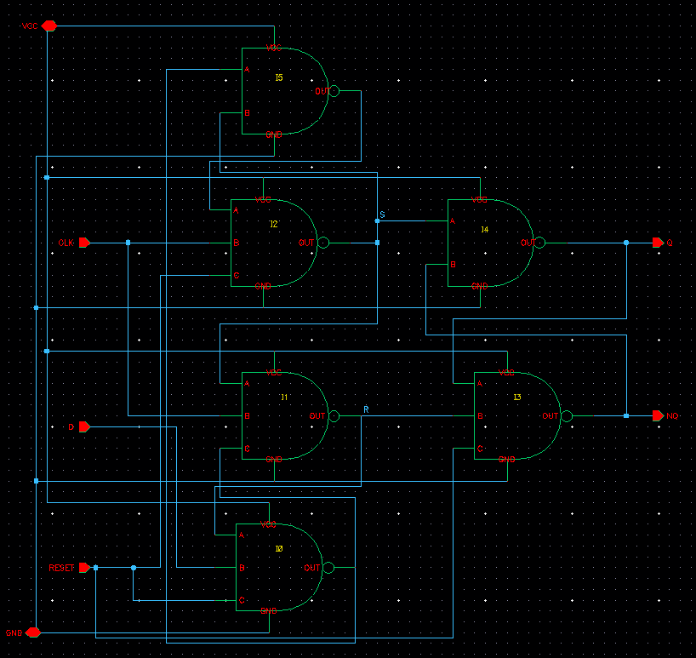
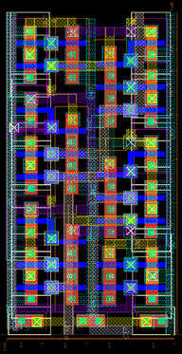
D-Flipflop
Easily validated the schematic
Substantially more difficult in layout
Resulting in a 7.5u x 3.8u DFF
Notes:
Seb

Slide 18
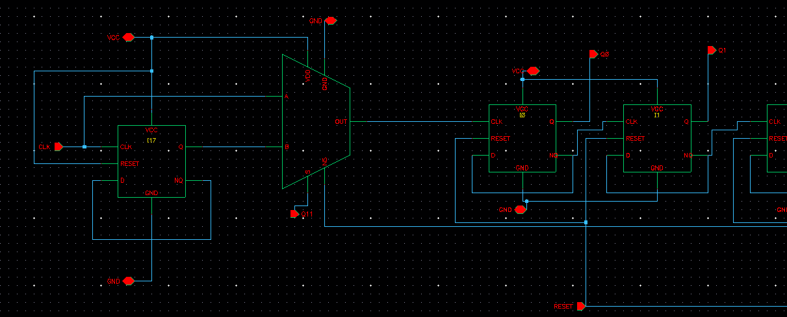
HDR Implementation
Multiplexer and frequency divider
Output of mux feeds into 1st bit of counter
Select line is 12th bit of counter
MUX
FREQUENCY DIVIDER
Notes:
Owen

Slide 19
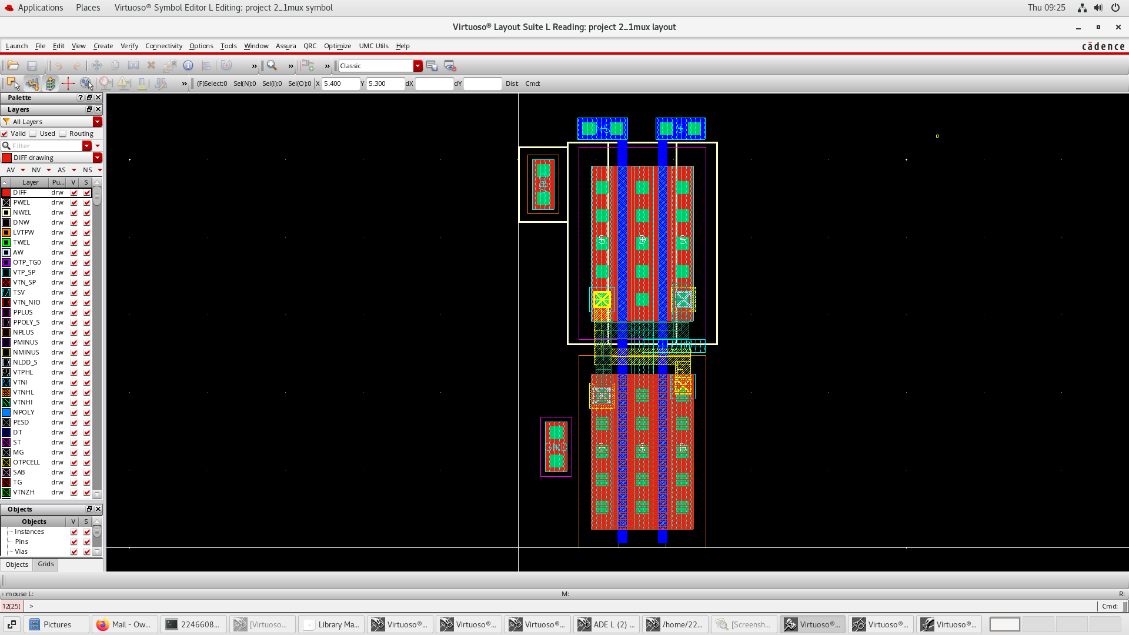
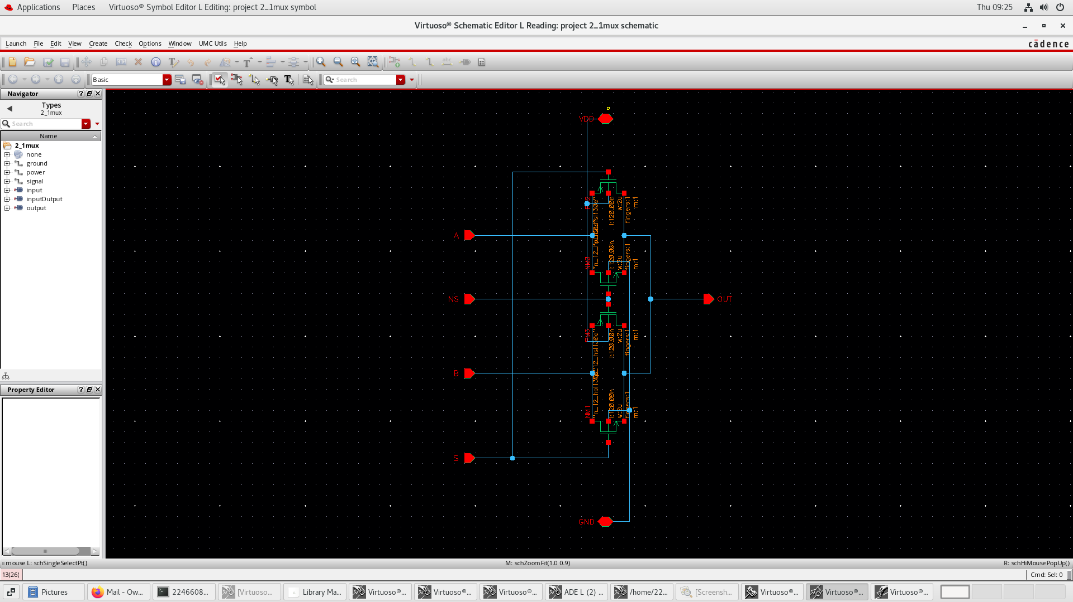
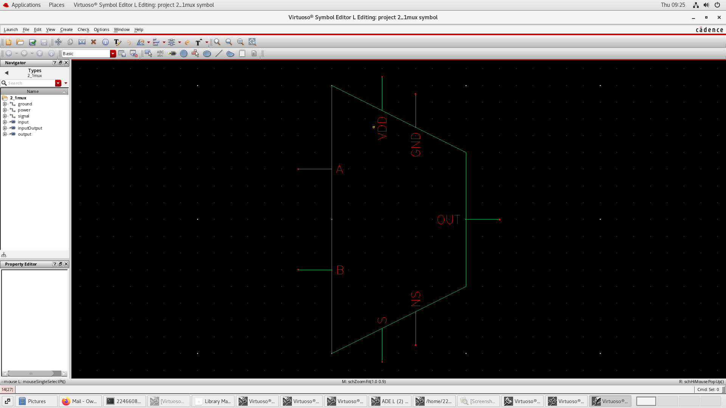
2–1 Multiplexer
Notes:
Jonny

Slide 20
Full Pixel Schematic

Slide 21
Feedback Circuit
Mega NAND (12–input NAND)
Feedback NAND
Notes:
Shami

Slide 22
Feedback Circuit – Simulation
COUNTER SATURATED, FLIPFLOPS HELD HIGH
1
1
1
1
1
1
1
1
Notes:
Shami

Slide 23
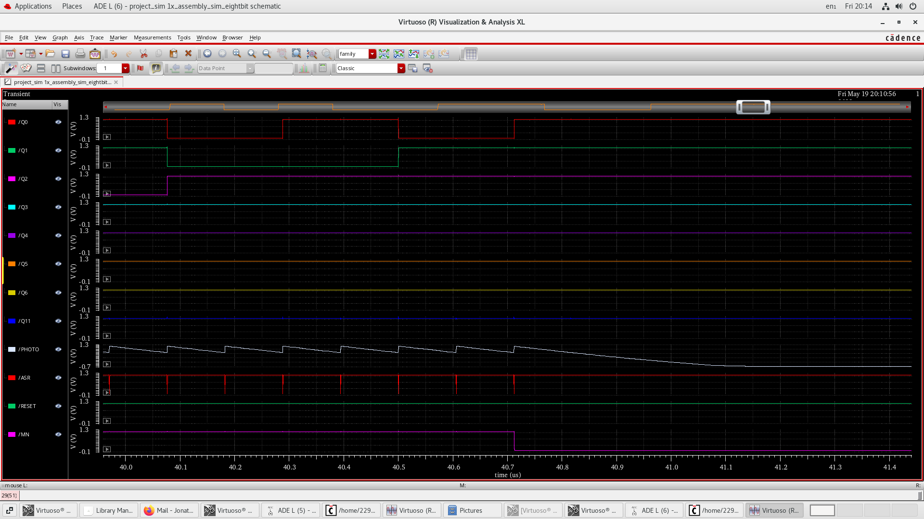
Feedback Circuit – Simulation Zoomed
COUNTER SATURATED, FLIPFLOPS HELD HIGH
1
1
1
1
1
1
1
1
Notes:
Shami

Slide 24
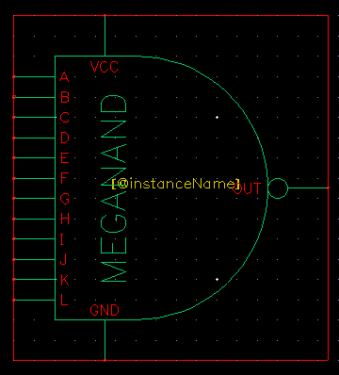
Mega-NAND – Symbol
Notes:
Jonny

Slide 25
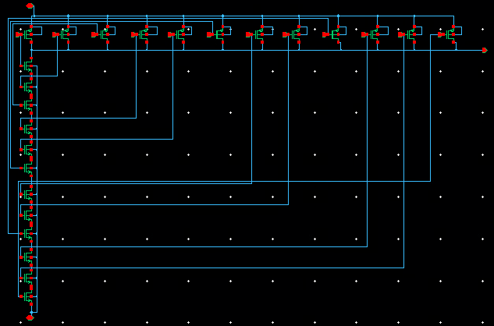
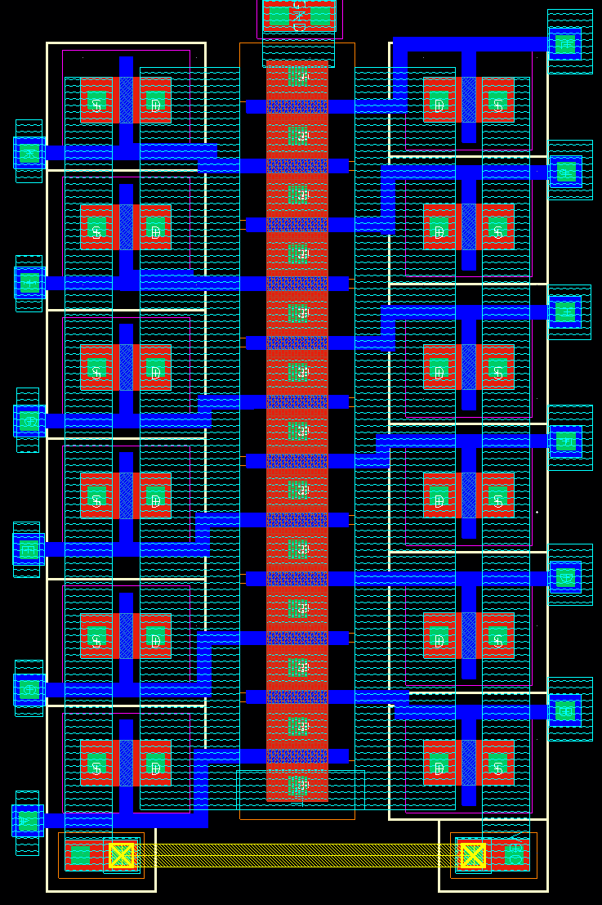
Mega-NAND – Schematic & Layout
Notes:
Jonny

Slide 26
Full Pixel Schematic

Slide 27
Reset Circuit
Pull up network as specified by project outline
Notes:
Shami

Slide 28
Full Pixel Schematic

Slide 29
Photodiode
Required approximately ~2.8u A to fully saturate the counter in the 100u s cycle.
10um x 10um
Notes:
Seb

Slide 30
Future Work
“The design is very human”
Faster design
Dynamic logic
Lower power consumption
Condensed layout
Notes:
Jonny

